Slide 1
Risk Aversion

Slide 2

Risk Aversion
Who is this guy?

Slide 3
Risk Aversion
Lets watch a portion of a video…
2:45 (specially)

Slide 4




Risk Aversion
Imagine a situation where River Plate plays against Boca Juniors and falls to 2nd division iff it loses
vs.
u(W,D) =
u(L) =

Slide 5

Risk Aversion
Utilities for this lottery
u(x)

Slide 6
Risk Aversion
Imagine a situation where River Plate plays against Boca Juniors and falls to 2nd division iff it loses
vs.
u(W,D) = $105
u(L) = -$105

Slide 7
Risk Aversion
What should I do if I am extremely risk averse?
vs.
u(W,D) = $105
u(L) = -$105

Slide 8
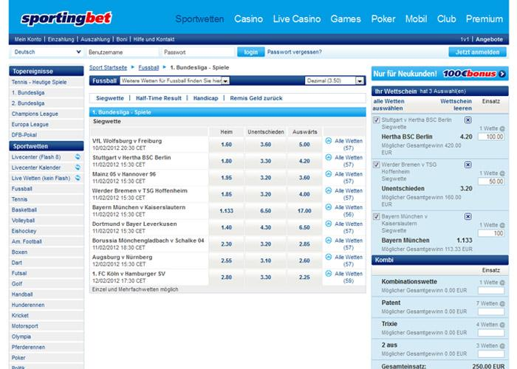
Risk Aversion
vs.

Slide 9

Risk Aversion
Suppose a site is paying r = 3 dollars for each dollar I put on Boca Juniors
Then...
let x be the amount of dollars I put on Boca Juniors
then, if u(W,D) – x = u(L) + (r-1)x, I have nothing to worry about!
105 – x = -105 + 3x - x
3x = 210
x = $70

Slide 10
Risk Aversion
Utilities for this lottery
u(x)

Slide 11
Risk Aversion
Utilities for this lottery
u(x)

Slide 12
Risk Aversion
… as if I am paying $70 for not playing this lottery

Slide 13
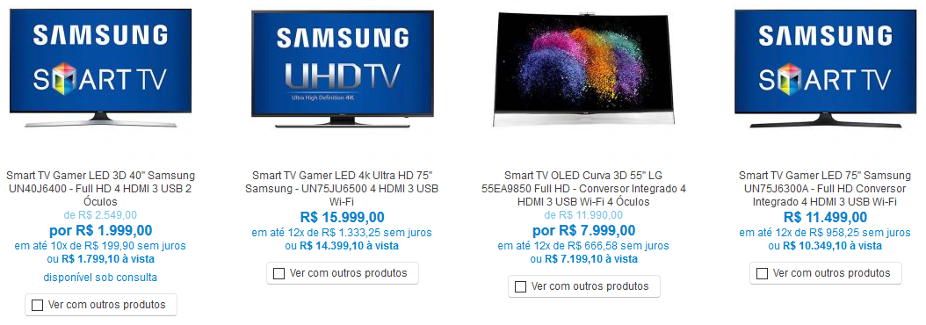
Lotteries with monetary prize
a
b
c
d
u(c) = $7.999,00

Slide 14
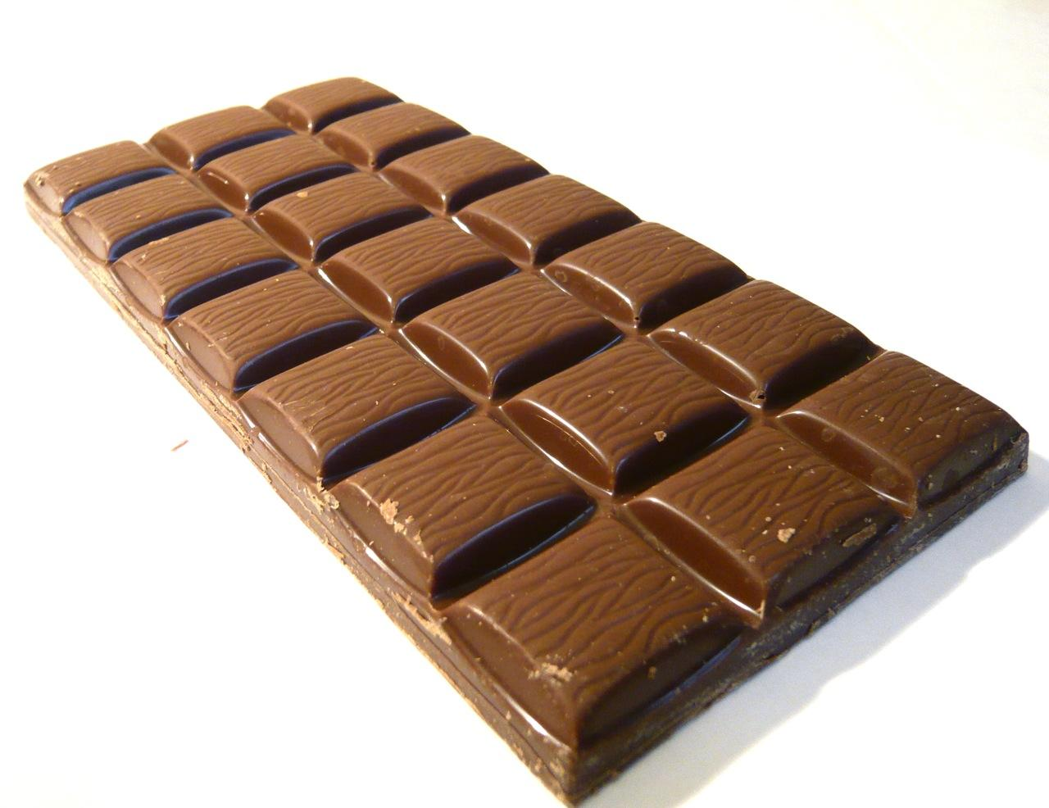

Lotteries with monetary prize
a
b
u(a) = $5,00
u(b) = $1.299,00

Slide 15
Lotteries with monetary prize
Preference relations ≿ over the space of lotteries for which there is a continuous function u, such that ≿ is represented by
The function Eu assigns to the lottery p the expectation of the random variable that receives the value u(x) with a probability p(x)

Slide 16
Lotteries with monetary prize
Which lottery do you prefer?
lottery | $30 | $50 | $70
p | 50% | 0% | 50%
q | 0% | 100% | 0%
Eu(p) = $50,00

Slide 17
Lotteries with monetary prize
Which lottery do you prefer?
lottery | $0 | $50 | $100
p | 50% | 0% | 50%
q | 0% | 100% | 0%
Eu(p) = $50,00

Slide 18
Lotteries with monetary prize
Which lottery do you prefer?
lottery | $0 | $30 | $100
p | 50% | 0% | 50%
q | 0% | 100% | 0%

Slide 19
Lotteries with monetary prize
Which lottery do you prefer?
lottery | $0 | $30M | $100M
p | 50% | 0% | 50%
q | 0% | 100% | 0%

Slide 20
Lotteries with monetary prize
Let's play a game...

Slide 21
Lotteries with monetary prize
Which lottery do you prefer?
lottery | $0 | $30M | $100M
p | 50% | 0% | 50%
q | 0% | 100% | 0%

Slide 22
Lotteries with monetary prize
Is there an x value that would make you choose p?
lottery | $0 | $30M | $[x]M
p | 50% | 0% | 50%
q | 0% | 100% | 0%

Slide 23

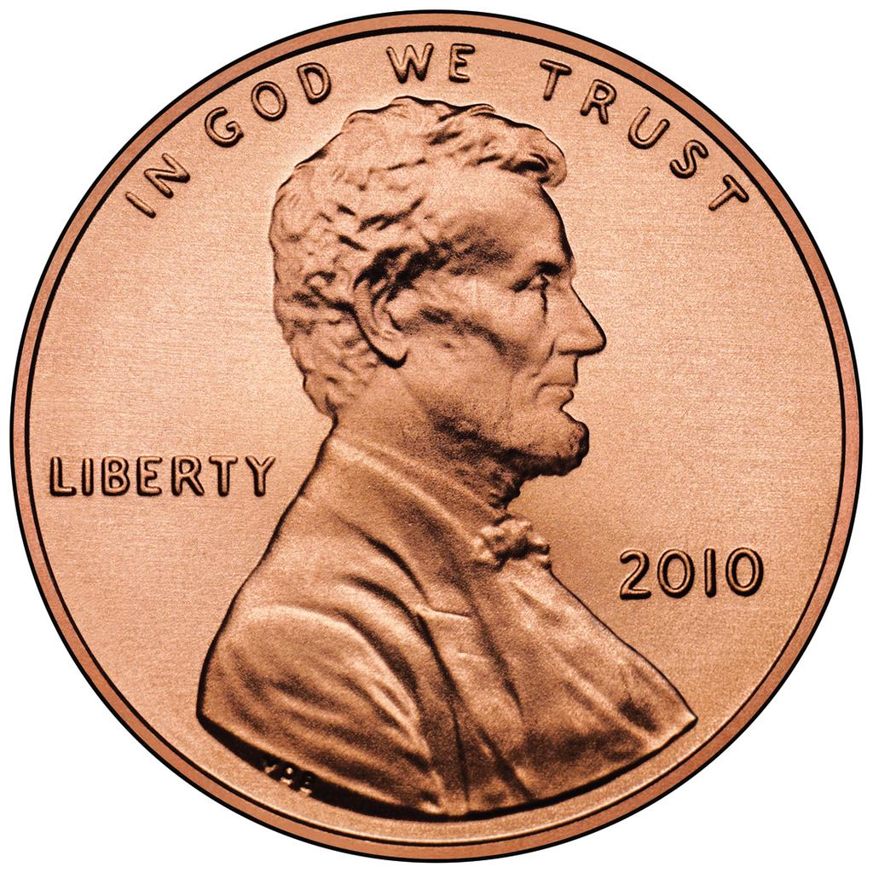
Lotteries with monetary prize
If yes, let's imagine the following situation…
Choose x₁ that will make you choose p
lottery | $0 | $30M | $[x₁]M
p | 50% | 0% | 50%
q | 0% | 100% | 0%
Now flip a coin

Slide 24

Lotteries with monetary prize
If yes, let's imagine the following situation…
Choose x₁ that will make you choose p
YOU WON!
lottery | $0 | $30M | $[x₁]M
p | 50% | 0% | 50%
q | 0% | 100% | 0%

Slide 25
Lotteries with monetary prize
If yes, let's imagine the following situation…
Choose x₂ that will make you choose p
lottery | $0 | $[x₁]M | $[x₂]M
p | 50% | 0% | 50%
q | 0% | 100% | 0%
Now flip a coin

Slide 26
Lotteries with monetary prize
If yes, let's imagine the following situation…
Choose now a x₂ that will make you choose p
YOU WON!
lottery | $0 | $[x₁]M | $[x₂]M
p | 50% | 0% | 50%
q | 0% | 100% | 0%

Slide 27
Lotteries with monetary prize
If yes, let's imagine the following situation…
Choose x₃ that will make you choose p
lottery | $0 | $[x₂]M | $[x₃]M
p | 50% | 0% | 50%
q | 0% | 100% | 0%
Now flip a coin

Slide 28

Lotteries with monetary prize
If utility is not bounded, this game goes on forever
More important:
What is the probability of our decision maker being left with no money?
1!
St. Petersburg paradox

Slide 29
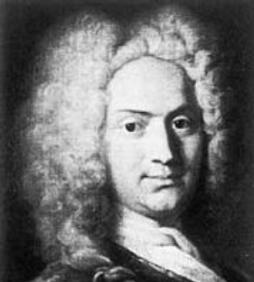
Lotteries with monetary prize
St. Petersburg paradox, proposed by Nicolaus Bernoulli more than 300 years ago

Slide 30
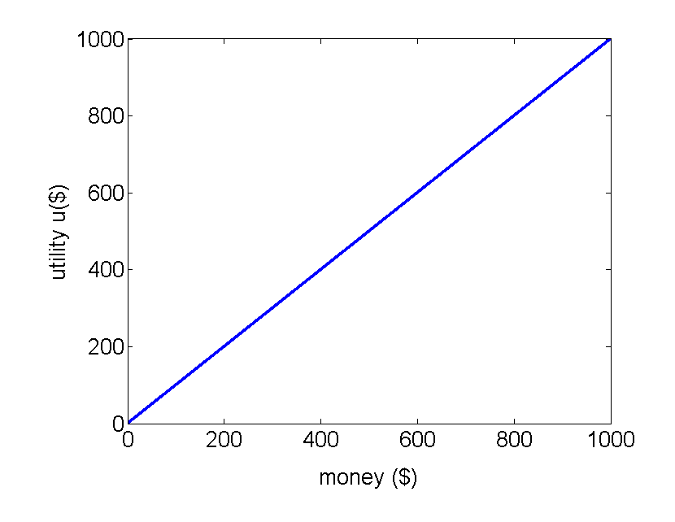
Lotteries with monetary prize
Money vs. Utility over money

Slide 31
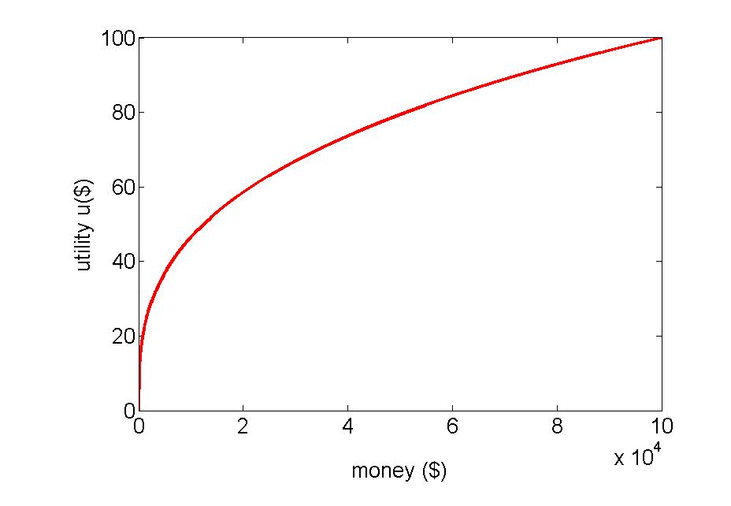
Lotteries with monetary prize
Money vs. Utility over money

Slide 32
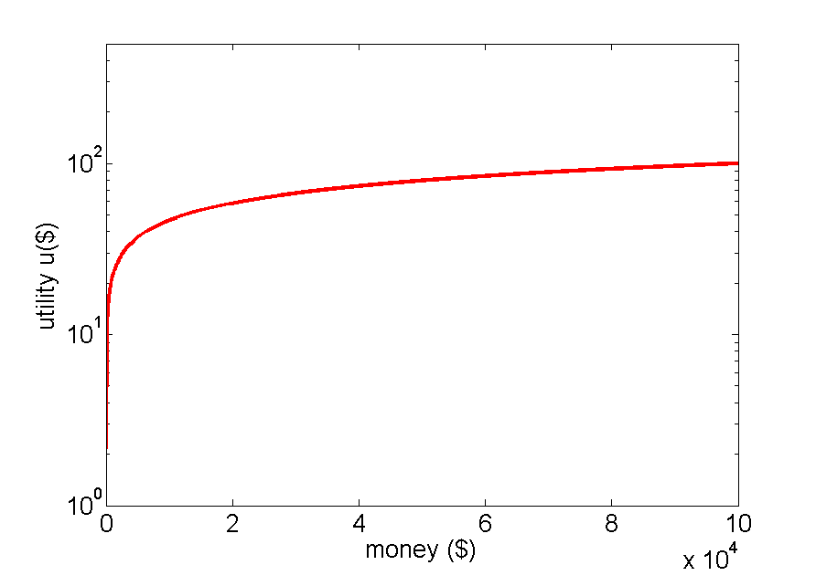
Lotteries with monetary prize
Money vs. Utility over money
Upper bounded

Slide 33
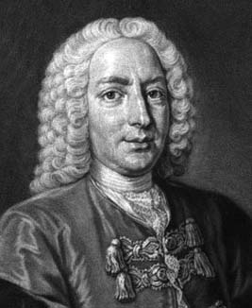
Lotteries with monetary prize
Daniel Bernoulli (cousin of Nicolaus) explains :
“The value of an item must not be based upon its price, but rather on the utility it yields.
The price of the item is dependent only on the thing itself and is equal for everyone.
The utility, however, is dependent on the particular circumstances of the person making the estimate.”

Slide 34
Lotteries with monetary prize
Two insights about the St. Petersburg paradox
The value attached to this gamble would vary across individuals, with some individuals willing to pay more than others
The utility from gaining an additional dollar would decrease with wealth
Utility increases as wealth increases and at a declining rate

Slide 35



Lotteries with monetary prize
The value attached to this gamble would vary across individuals, with some individuals willing to pay more than others

Slide 36
Risk Aversion
How to measure?

Slide 37
Risk Aversion
How to measure?
Every prize should be converted to money
Define a utility function u($) over money
For a lottery p over prizes, calculate:
E(p): the expected amount of money of lottery p
Eu(p): the expected utility of lottery p
u(E(p)): the utility of the expected amount of money of p
CE(p): the certainty equivalent
the amount of money I am willing to pay to play lottery p

Slide 38
Risk Aversion
How much would you pay to play lottery p?
Let CE(p), the certainty equivalent, be the amount of money I am willing to pay to play lottery p
How much A and B value to you?
u(A) and u(B) (or u($20) and u($80))
Eu(p) = p(A)u(A) + p(B)u(B) = 0.25 u($20) + 0.75 u($80)
E(p) = p(A)A + p(B)B = 0.25 $20 + 0.75 $80 = $65
If I am risk neutral
u(E(p)) = Eu(p) and E(p) = CE(p) = $65
lottery | A($20) | B($80)
p | 25% | 75%

Slide 39
Risk Aversion
How much would you pay to play lottery p?
Let CE(p), the certainty equivalent, be the amount of money I am willing to pay to play lottery p
How much A and B value to you?
u(A) and u(B) (or u($20) and u($80))
Eu(p) = p(A)u(A) + p(B)u(B) = 0.25 u($20) + 0.75 u($80)
E(p) = p(A)A + p(B)B = 0.25 $20 + 0.75 $80 = $65
If I am risk averse
u(E(p)) > Eu(p) and E(p) > CE(p) < $65
lottery | A($20) | B($80)
p | 25% | 75%

Slide 40
Risk Aversion
How much would you pay to play lottery p?
Let CE(p), the certainty equivalent, be the amount of money I am willing to pay to play lottery p
How much A and B value to you?
u(A) and u(B) (or u($20) and u($80))
Eu(p) = p(A)u(A) + p(B)u(B) = 0.25 u($20) + 0.75 u($80)
E(p) = p(A)A + p(B)B = 0.25 $20 + 0.75 $80 = $65
If I am risk seeking
u(E(p)) < Eu(p) and E(p) < CE(p) > $65
lottery | A($20) | B($80)
p | 25% | 75%

Slide 41
Risk Aversion
Claim:
Let ≿ be a preference on L(Z) represented by the vNM utility function u,
the preference relation ≿ is risk averse iff u is
strictly concave
Proof
In the book

Slide 42
Reminder: strictly concave functions
f((1-α)x + αy) > (1-α)f(x) + αf(y)
consider a lottery with two prizes x and y
and p(y) = α and p(x) = 1-α
E(p) = (1-α)x + αy
if the function f is strictly concave
f(E(p)) > (1-α)f(x) + αf(y)
if f is the utility function
u(E(p)) > (1-α)u(x) + αu(y)
u(E(p)) > Eu(p) (definition of risk aversion)

Slide 43
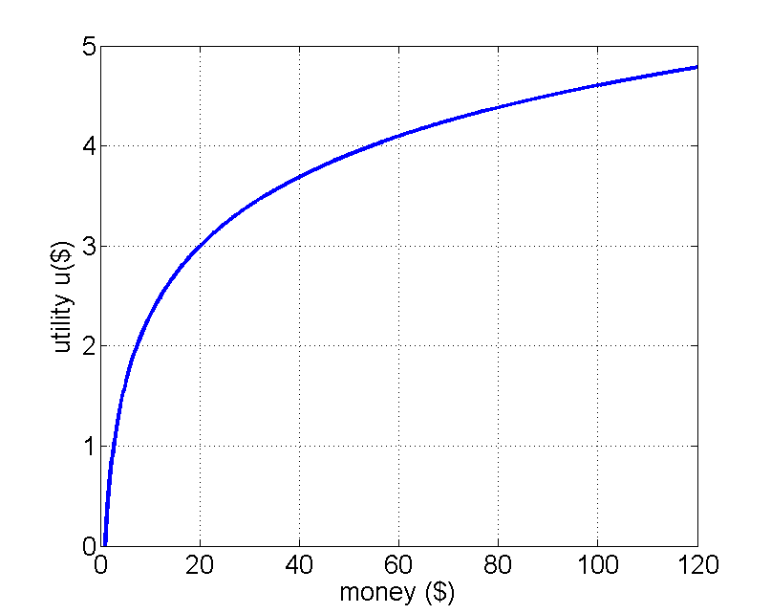
Risk Aversion
u(x) = ln(x)
p = (0.5) $20 ⊕ (0.5) $100

Slide 44
Risk Aversion
u(x) = ln(x)
p = (0.5) $20 ⊕ (0.5) $100
E(p) = 0.5 * 20 + 0.5 * 100 = 60
u(E(p)) = ln(60) = 4.09

Slide 45
Risk Aversion
u(x) = ln(x)
p = (0.5) $20 ⊕ (0.5) $100
(E(p), u(E(p)))
Eu(p) = 0.5ln(20) + 0.5ln(100) = 3.80

Slide 46
Risk Aversion
u(x) = ln(x)
p = (0.5) $20 ⊕ (0.5) $100
(E(p), u(E(p)))
(E(p), Eu(p))
u(CE(p)) = Eu(p)
ln(CE(p)) = 3.80, CE(p) = 44.70

Slide 47
Risk Aversion
u(x) = ln(x)
p = (0.5) $20 ⊕ (0.5) $100
(E(p), u(E(p)))
(CE(p),u(CE(p)))
(E(p), Eu(p))
R(p) = E(p) – CE(p) = 60 – 44.70 = 15.30

Slide 48
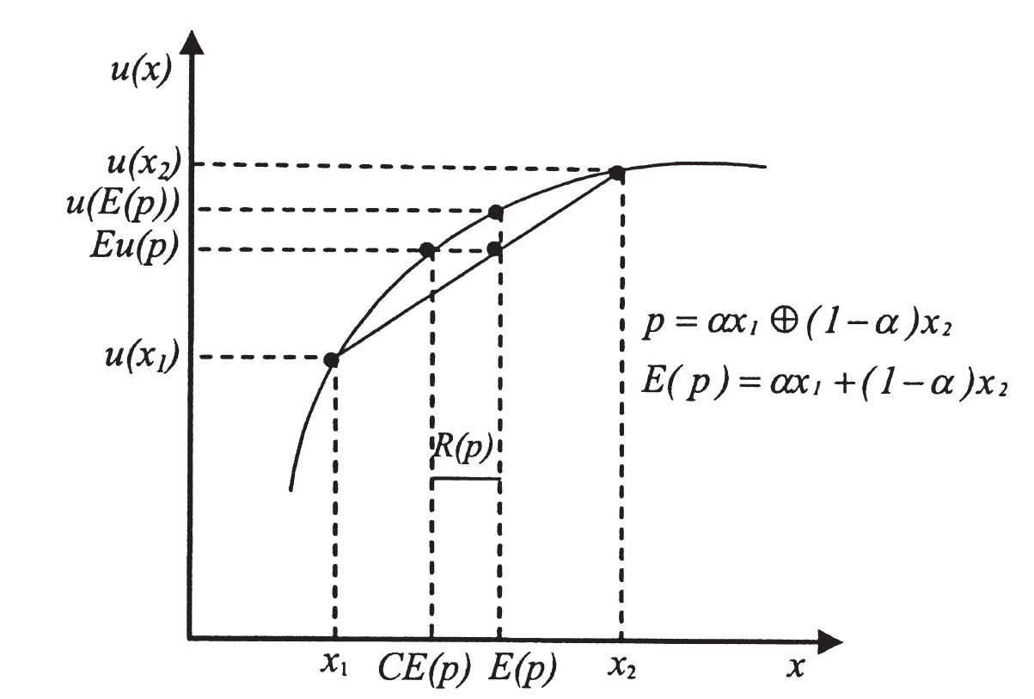
Risk Aversion
Risk premium R(p)
R(p) = E(p) - CE(p)

Slide 49
Risk Aversion
Claim:
The preference relation ≿₁ is more risk averse than ≿₂ if CE₁(p) ≤ CE₂(p) for all p

Slide 50
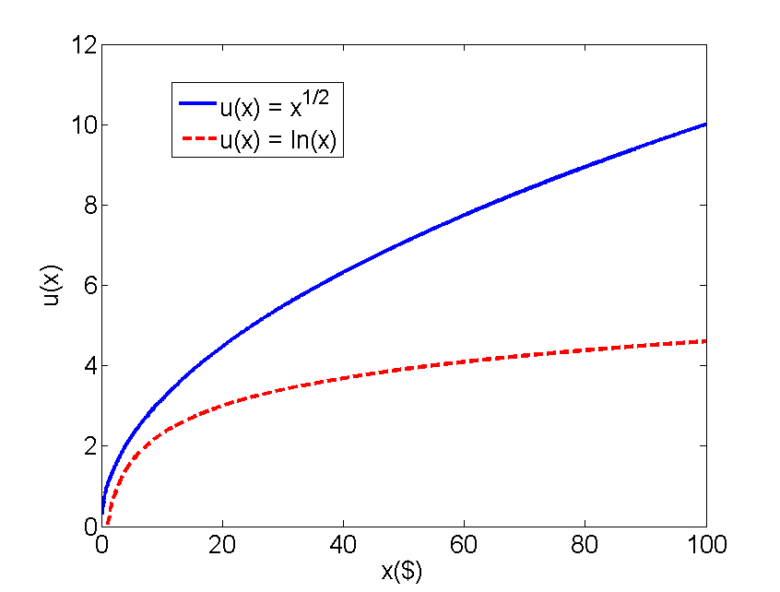
Risk Aversion
Which individual is more risk averse?

Slide 51
Risk Aversion
Another definition of the relation “more risk averse” exists when vNM utility functions are twice differentiable:
Let u₁ and u₂ be twice differentiable vNM utility functions representing ≿₁ and ≿₂, respectively
The preference relation ≿₁ is more risk averse than ≿₂ if r₁(x) ≥ r₂(x) for all x, where
r_{i}(x) = −u′′_{i}(x)/u′_{i}(x)
The number r(x) is called the coefficient of absolute risk aversion of u at x
A higher coefficient of absolute risk aversion means a more risk-averse decision maker

Slide 52
Risk Aversion
Which individual is more risk averse?

Slide 53
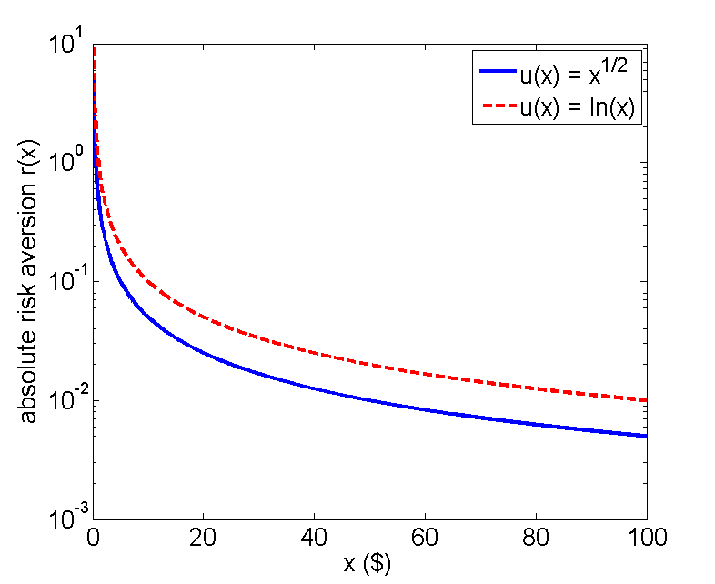
Risk Aversion
Absolute risk aversion coefficient r
r(x) = -u''(x) / u'(x)

Slide 54
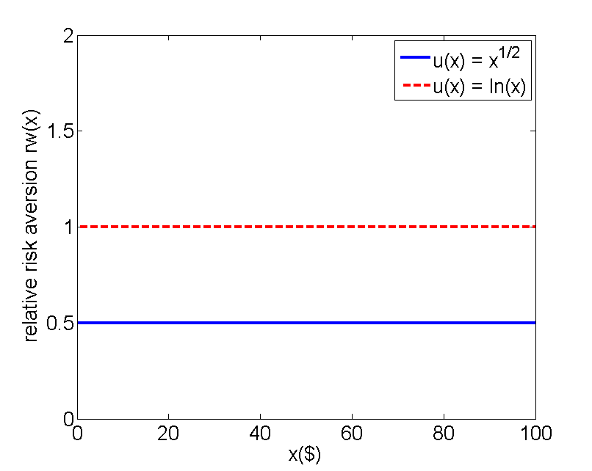
Risk Aversion
Relative risk aversion coefficient rw
rw(x) = x r(x)

Slide 55
Risk Aversion
Absolute risk aversion coefficient r
If r(x) decreases with x, then individuals will invest larger money amounts in risky assets as they get wealthier
Relative risk aversion coefficient rw
If rw(x) is constant with x, individuals will invest the same percentage of their wealth in risky assets as they get wealthier

Slide 56
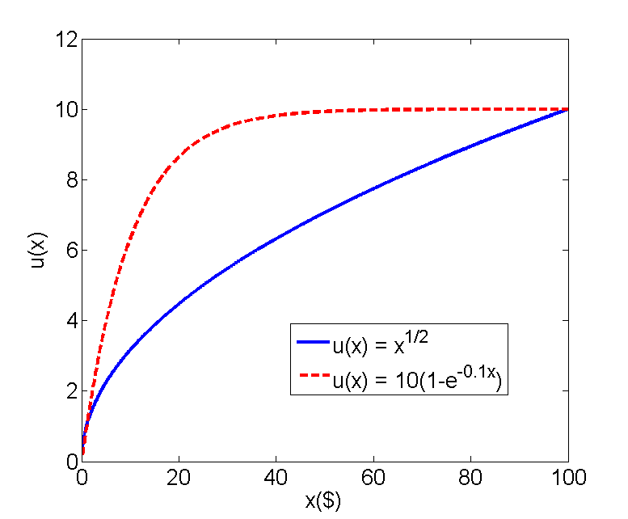
Risk Aversion
Which individual is more risk averse?

Slide 57
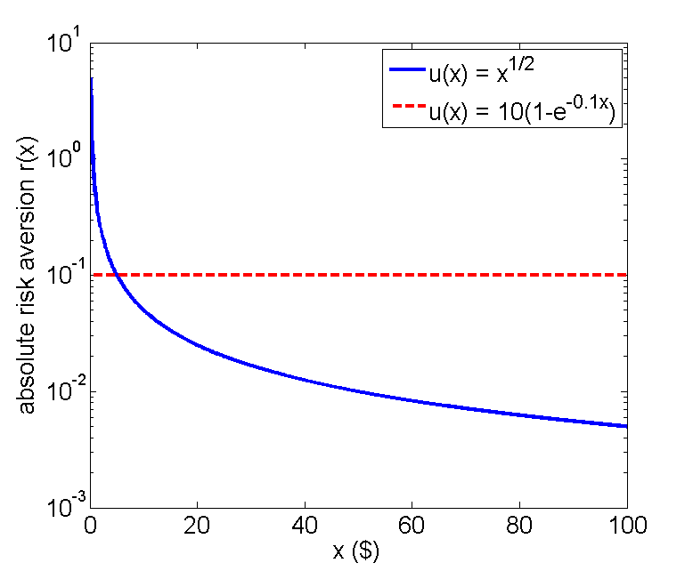
Risk Aversion
Absolute risk aversion coefficient r
r(x) = -u''(x) / u'(x)

Slide 58
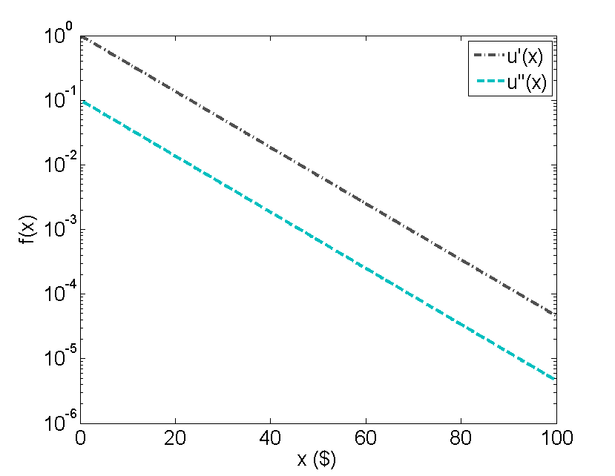
Risk Aversion
Absolute risk aversion coefficient r
u(x) = 10(1-e^{-0.1x})

Slide 59
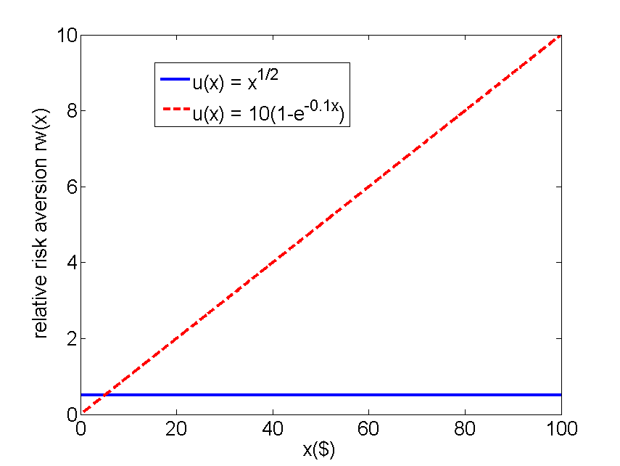
Risk Aversion
Relative risk aversion coefficient rw
rw(x) = x r(x)

Slide 60
Risk Aversion
What happens with an agent represented by the red curve?

Slide 61
Risk Aversion
Absolute risk aversion coefficient r
With constant r(x), the amount of wealth that we expose to risk remains constant as wealth increases
Invariance to wealth
Relative risk aversion coefficient rw
If rw(x) is increasing with x, individuals will invest less percentage of their wealth in risky assets as they get wealthier

Slide 62
Invariance to Wealth
Claim:
Assume that u is a vNM utility function representing preferences ≿, which are monotonic and exhibit invariance to wealth
Then u must be exponential or linear
Proof in the book

Slide 63
First-Order Stochastic Domination
Is there other ways to compare lotteries besides using the expected utility Eu?
Now we see when a lottery p first-order stochastically dominates a lottery q
Or pD₁ q

Slide 64
First-Order Stochastic Domination
Which lottery do you prefer?
 | $0 | $20 | $50 | $100 | $200
p | 0.1 | 0.1 | 0.2 | 0.3 | 0.3
q | 0.15 | 0.05 | 0.25 | 0.35 | 0.20

Slide 65
First-Order Stochastic Domination
Which lottery do you prefer?
G(p,x) = Σ_{z ≥ x} p(z)
 | $0 | $20 | $50 | $100 | $200
G(p,x) | 1 (0.1) | 0.9 (0.1) | 0.8 (0.2) | 0.6 (0.3) | 0.3 (0.3)
G(q,x) | 1 (0.15) | 0.85 (0.05) | 0.8 (0.25) | 0.55 (0.35) | 0.2 (0.20)

Slide 66
First-Order Stochastic Domination
Which lottery do you prefer?
F(p,x) = Σ_{z ≤ x} p(z)
 | $0 | $20 | $50 | $100 | $200
F(p,x) | 0.1 (0.1) | 0.2 (0.1) | 0.4 (0.2) | 0.7 (0.3) | 1 (0.3)
F(q,x) | 0.15 (0.15) | 0.2 (0.05) | 0.45 (0.25) | 0.80 (0.35) | 1 (0.20)

Slide 67
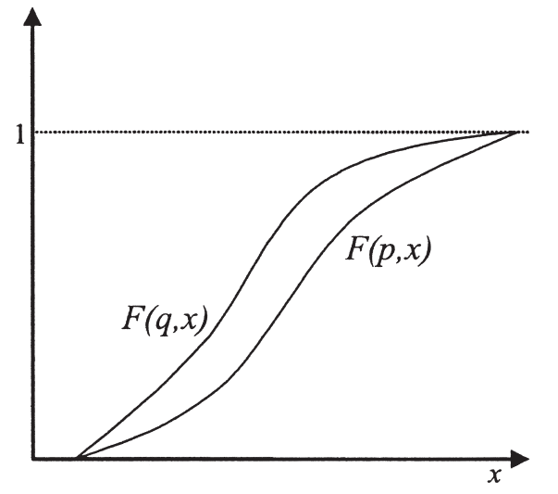
First-Order Stochastic Domination
Claim:
pD₁q iff for all x, G(p, x) ≥ G(q, x) or
pD₁q iff for all x, F(p, x) ≤ F(q, x)

